Slide 1
Data Vizualization
Jenn Halbleib
2017

Slide 2
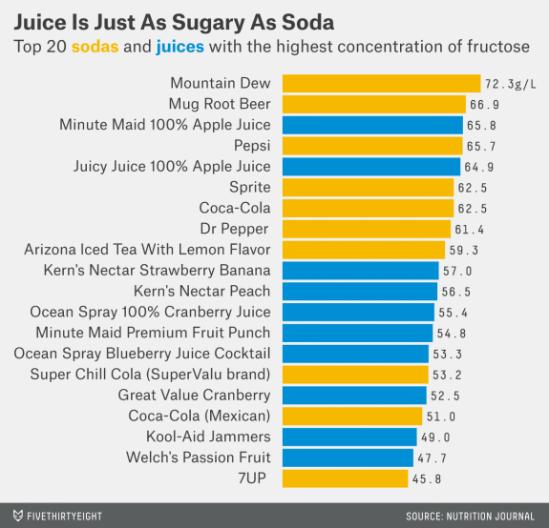
“Good” Graphic
Product Name | Sugar grams/L | Juice or Soda
Mountain Dew | 72.3 | Soda
Etc.
Sugar grams/L column is sorted in decreasing order
Color dimension: built from the juice or soda column
X-axis: Sugar gram/L
Y-axis: Brand
Label: Sugar gram/L
Source: https://fivethirtyeight.com/datalab/dairy-queen-will-nix-sodas-from-its-kids-menu-but-that-may-not-be-enough/

Slide 3
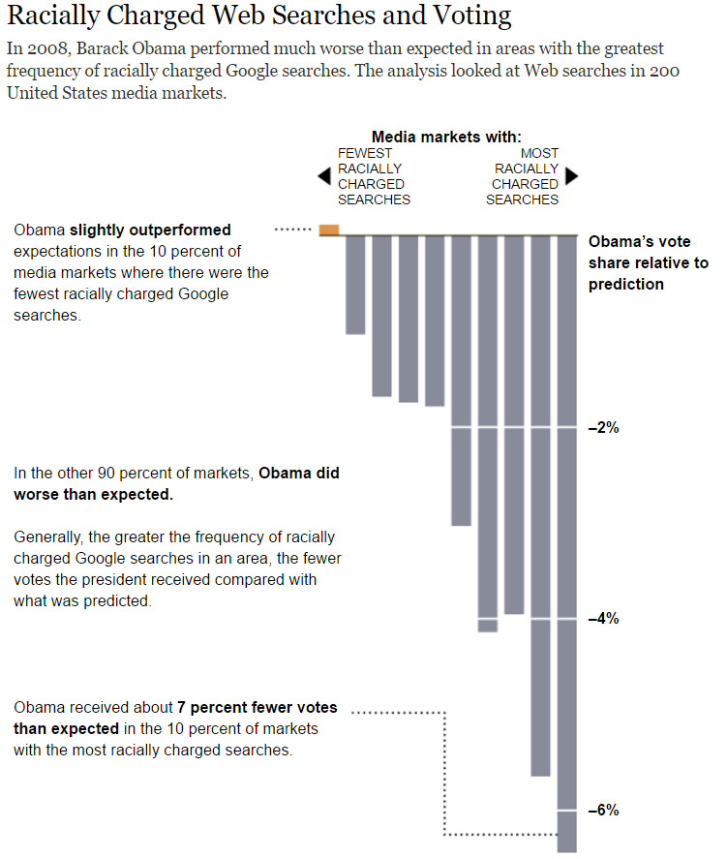
“Needs Work” Graphic
Media Market Number | Difference between received and expected vote share | Sign of Vote Share (+/-)
1 | % | +
Etc.
Media Markets ranked by percentile of racially charged searches from lowest 10% to highest 10%
Sign of Vote Share determines color dimension
What’s weird?
Graph oriented top down
One colored bar doesn’t add that much information and over exaggerates a small positive assocation
Source: http://www.nytimes.com/interactive/2012/06/10/sunday-review/racially-charged-web-searches-and-voting.html

Slide 4
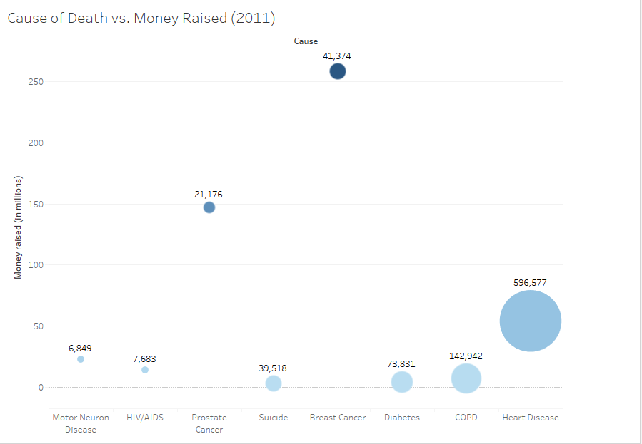
My Graph from Vox Data

